Slide 1
Cassandra tuning - above and beyond
Matija Gobec
Co-founder & Senior Consultant @ SmartCat.io

Slide 2
Why this talk
We were challenged with an interesting requirement…
“99.999%”
© DataStax, All Rights Reserved.

Slide 3
1 | Initial investigation and setup
2 | Metrics and reporting
3 | Test setup
4 | AWS deployment
5 | Did we make it?
© DataStax, All Rights Reserved.

Slide 4
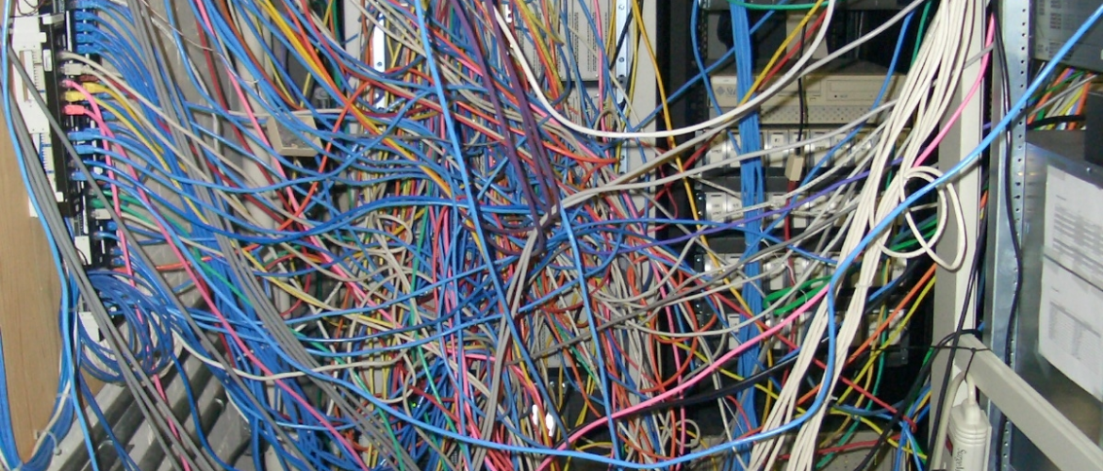
What makes a distributed system?
A bunch of stuff that magically works together
© DataStax, All Rights Reserved.

Slide 5
How to start?
Investigate the current setup (if any)
Understand your use case
Understand your data
Set a base configuration
Define target performance (goal)
© DataStax, All Rights Reserved.

Slide 6
Initial investigation
What type of deployment are you working with?
What is the available hardware?
CPU cores and threads
Memory amount and type
Storage size and type
Network interfaces amount and type
Limitations
© DataStax, All Rights Reserved.

Slide 7
Hardware and setup

Slide 8
Hardware configuration
8-16 cores
32GB ram
Commit log SSD
Data drive SSD
10GbE
Placement groups
Availability zones
Enhanced networking
© DataStax, All Rights Reserved.

Slide 9
OS - Swap, storage, cpu
Swap is bad
remove swap from stab
disable swap: swapoff -a
Optimize block layer
echo 1 > /sys/block/XXX/queue/nomerges
echo 8 > /sys/block/XXX/queue/read_ahead_kb
echo deadline > /sys/block/XXX/queue/scheduler
Disable cpu scaling
© DataStax, All Rights Reserved.

Slide 10
sysctl.d - network
net.ipv4.tcp_rmem = 4096 87380 16777216
net.ipv4.tcp_wmem = 4096 65536 16777216
net.ipv4.tcp_ecn = 0
net.ipv4.tcp_window_scaling = 1
net.ipv4.ip_local_port_range = 10000 65535
net.ipv4.tcp_tw_recycle = 1
net.core.rmem_max = 16777216
net.core.wmem_max = 16777216
net.core.somaxconn = 4096
net.core.netdev_max_backlog = 16384
# read buffer space allocatable in units of pages
# write buffer space allocatable in units of pages
# disable explicit congestion notification
# enable window scaling (higher throughput)
# allowed local port range
# enable fast time-wait recycle
# max socket receive buffer in bytes
# max socket send buffer in bytes
# number of incoming connections
# incoming connections backlog
© DataStax, All Rights Reserved.

Slide 11
sysctl.d - vm and fs
vm.swappiness = 1
vm.max_map_count = 1073741824
vm.dirty_background_bytes = 10485760
vm.dirty_bytes = 1073741824
fs.file-max = 1073741824
vm.min_free_kbytes = 1048576
# memory swapping threshold
# max memory map areas a process can have
# dirty memory amount threshold (kernel)
# dirty memory amount threshold (process)
# max number of open files
# min number of VM free kilobytes
© DataStax, All Rights Reserved.

Slide 12
JVM - CMS
MAX_HEAP_SIZE=“8G" # Good starting point
HEAP_NEWSIZE=“2G" # Good starting point
JVM_OPTS="$JVM_OPTS -XX:+PerfDisableSharedMem"
JVM_OPTS="$JVM_OPTS -XX:-UseBiasedLocking”
# Tunable settings
JVM_OPTS="$JVM_OPTS -XX:SurvivorRatio=2"
JVM_OPTS="$JVM_OPTS -XX:MaxTenuringThreshold=16"
JVM_OPTS="$JVM_OPTS -XX:+UnlockDiagnosticVMOptions"
JVM_OPTS="$JVM_OPTS -XX:ParGCCardsPerStrideChunk=4096”
# Instagram settings
JVM_OPTS="$JVM_OPTS -XX:+CMSScavengeBeforeRemark"
JVM_OPTS="$JVM_OPTS -XX:CMSMaxAbortablePrecleanTime=60000"
JVM_OPTS="$JVM_OPTS -XX:CMSWaitDuration=30000"
© DataStax, All Rights Reserved.

Slide 13
JVM - G1GC
JVM_OPTS="$JVM_OPTS -XX:+UseG1GC"
JVM_OPTS="$JVM_OPTS -XX:MaxGCPauseMillis=500"
JVM_OPTS="$JVM_OPTS -XX:G1RSetUpdatingPauseTimePercent=5"
JVM_OPTS="$JVM_OPTS -XX:InitiatingHeapOccupancyPercent=25”
JVM_OPTS="$JVM_OPTS -XX:ParallelGCThreads=16” # Set to number of full cores
JVM_OPTS="$JVM_OPTS -XX:ConcGCThreads=16” # Set to number of full cores
© DataStax, All Rights Reserved.

Slide 14
Cassandra
concurrent_reads: 128
concurrent_writes: 128
concurrent_counter_writes: 128
memtable_allocation_type: heap_buffers
memtable_flush_writers: 8
memtable_cleanup_threshold: 0.15
memtable_heap_space_in_mb: 2048
memtable_offheap_space_in_mb: 2048
trickle_fsync: true
trickle_fsync_interval_in_kb: 1024
internode_compression: dc
© DataStax, All Rights Reserved.

Slide 15
Data model and compaction strategy

Slide 16
Data model
Data model impacts performance a lot
Optimize so that you read from one partition
Make sure your data can be distributed
SSTable compression depending on the use case
© DataStax, All Rights Reserved.

Slide 17
Compaction strategy
Size tiered compaction strategy
Good as a default
Performance and size constraints
Leveled compaction strategy
Great for low latency read requirements
Constant compactions
Date tiered / Time window compaction strategy
Good fit for time series use cases
© DataStax, All Rights Reserved.

Slide 18
Ok, what now?
After we set the base configuration it’s time for testing and observing
© DataStax, All Rights Reserved.

Slide 19
Metrics and reporting stack

Slide 20
Metrics and reporting stack
OS metrics (SmartCat)
Metrics reporter config (AddThis)
Cassandra diagnostics (SmartCat)
Filebeat
Riemann
InfluxDB
Grafana
Elasticsearch
Logstash
Kibana
© DataStax, All Rights Reserved.

Slide 21
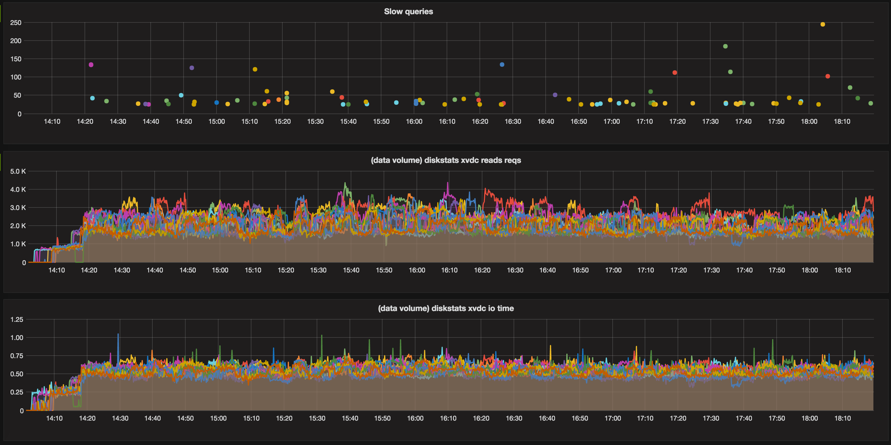
Grafana
© DataStax, All Rights Reserved.

Slide 22
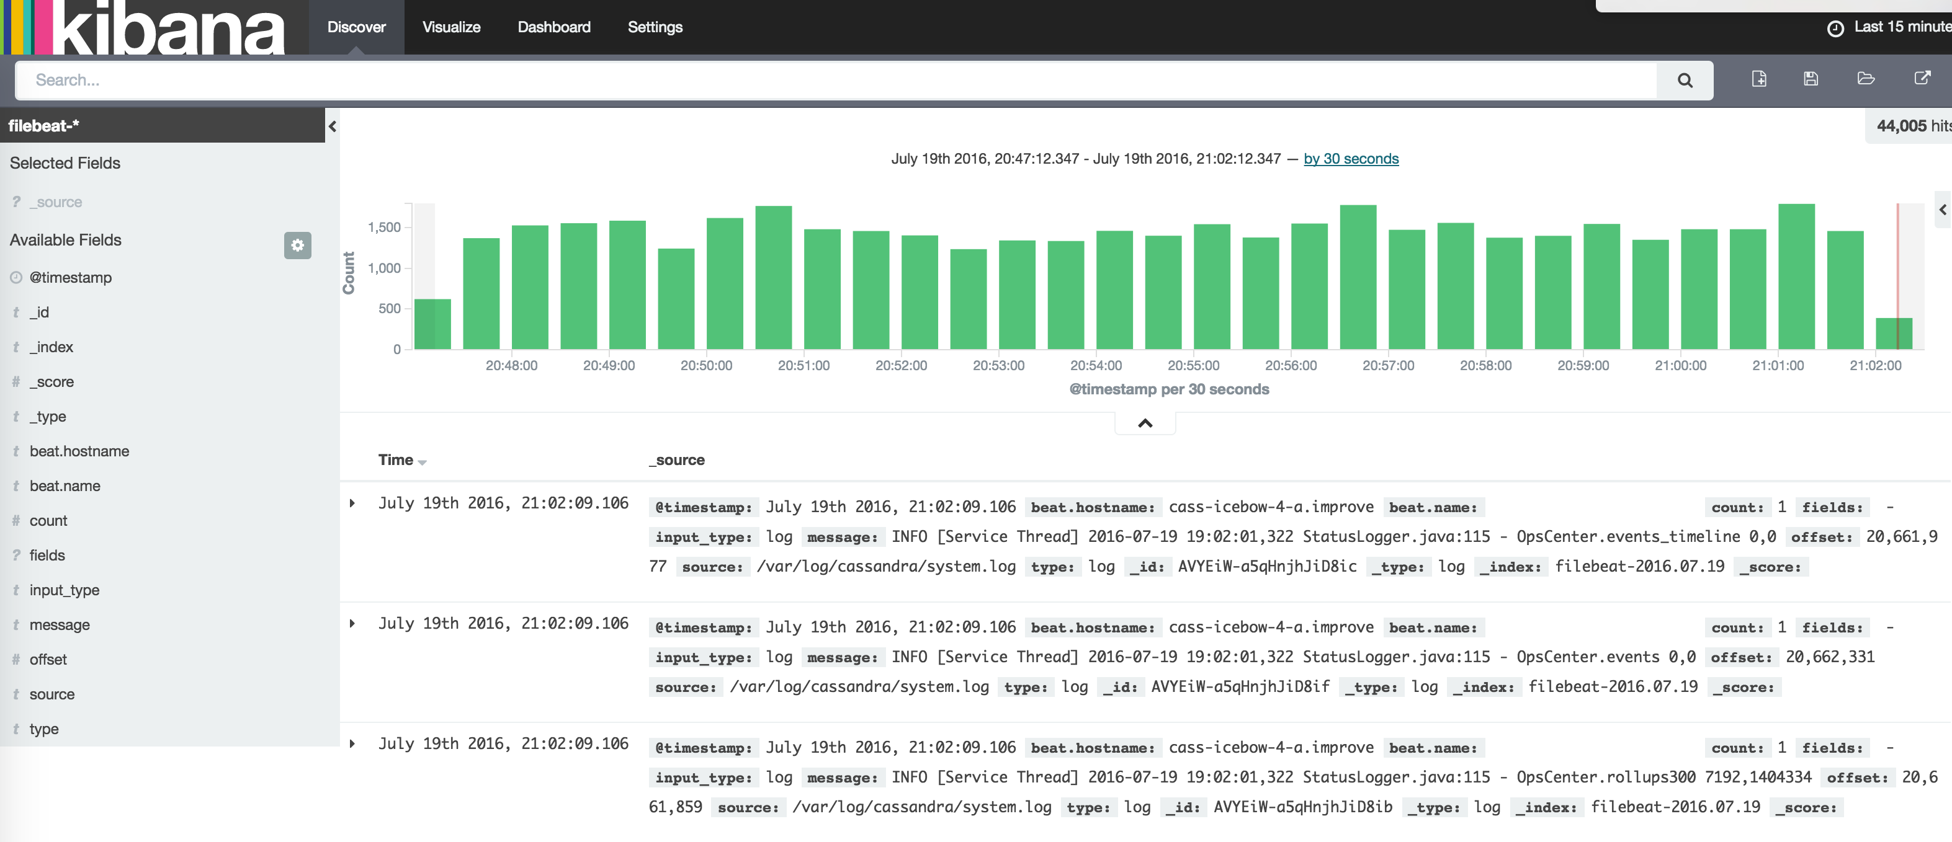
Kibana
© DataStax, All Rights Reserved.

Slide 23
Slow queries
Track query execution times above some threshold
Gain insights into the long processing queries
Relate that to what’s going on on the node
Compare app and cluster slow queries
https://github.com/smartcat-labs/cassandra-diagnostics
© DataStax, All Rights Reserved.

Slide 24
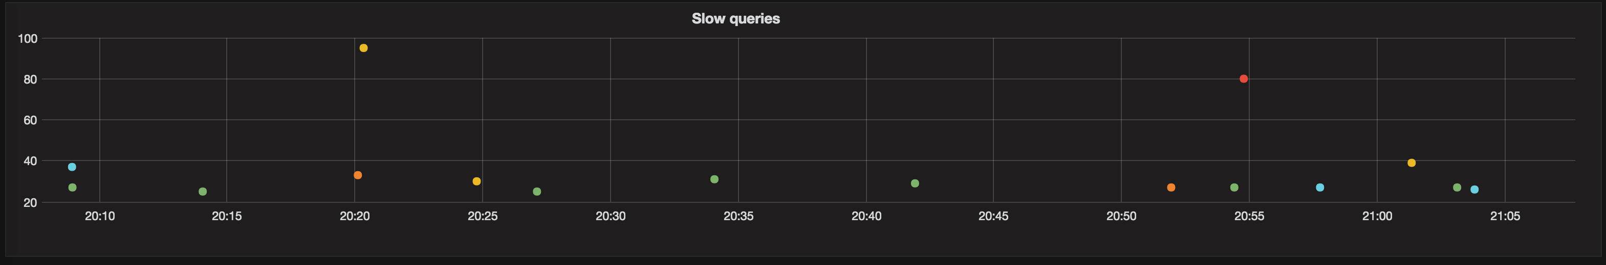
Slow queries - cluster
© DataStax, All Rights Reserved.

Slide 25
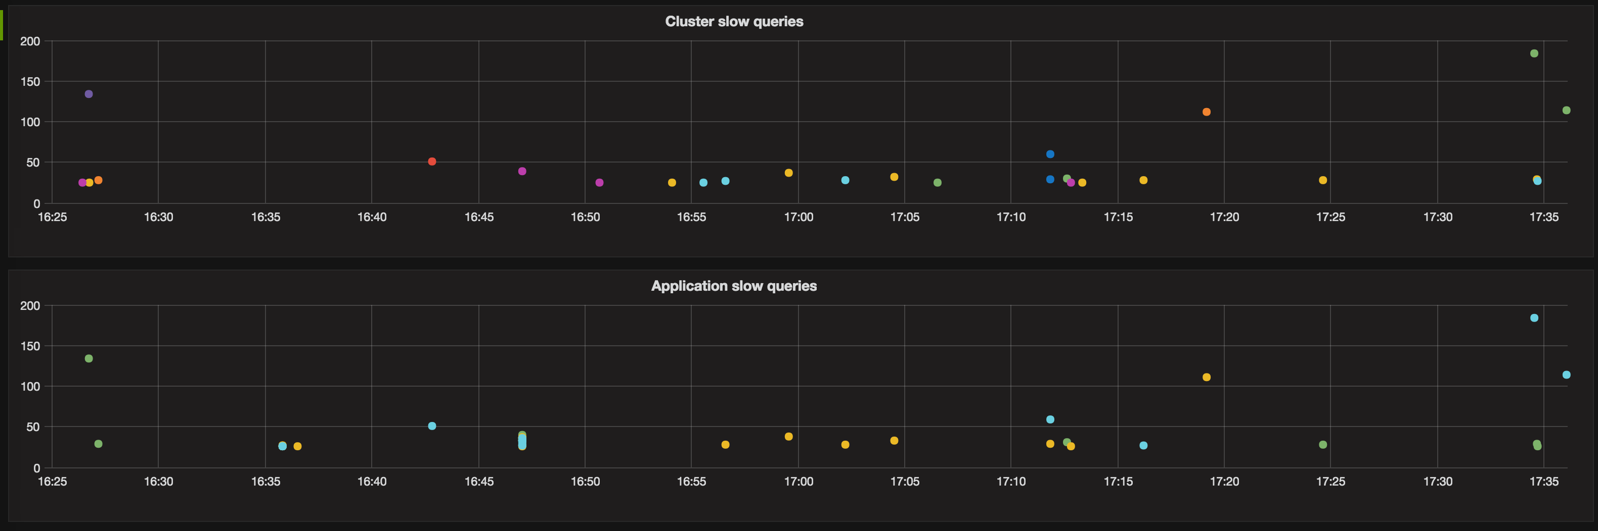
Slow queries - cluster vs app
© DataStax, All Rights Reserved.

Slide 26
Ops center
Pros:
Great when starting out
Everything you need in a nice GUI
Cluster metrics
Cons:
Metrics stored in the same cluster
Issues with some of the services (repair, slow query,...)
Additional agents on the nodes
© DataStax, All Rights Reserved.

Slide 27
Test setup

Slide 28
Test setup
Make sure you have repeatable tests
Fixed rate tests
Variable rate tests
Production like tests
Cassandra Stress
Various loadgen tools (gatling, wrk, loader,...)
© DataStax, All Rights Reserved.

Slide 29
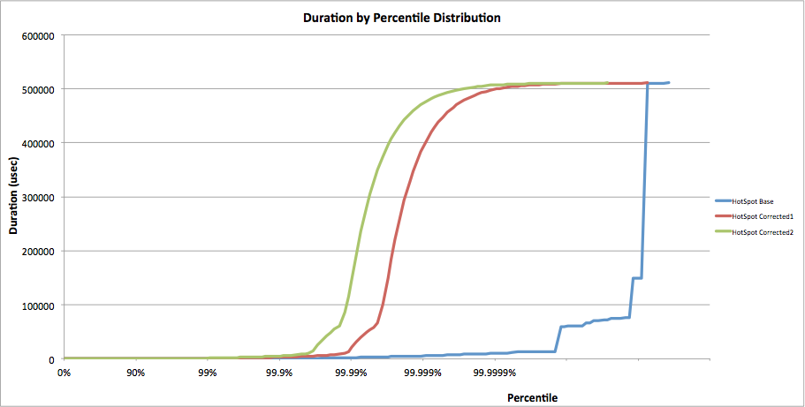
Coordinated omission
© DataStax, All Rights Reserved.

Slide 30
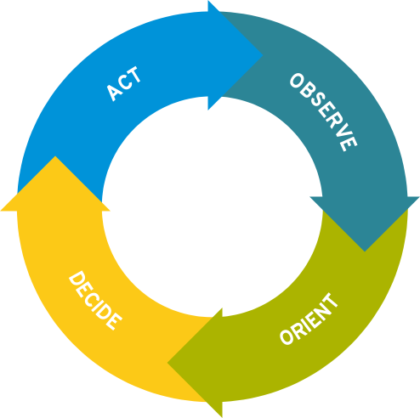
Tuning methodology
© DataStax, All Rights Reserved.

Slide 31

AWS

Slide 32
AWS deployment
Choose your instance based on calculations
Use placement groups and availability zones
Don’t overdo it just because you can ($$$)
Are you sure you need ephemeral storage?
Go for EBS volumes (gp2)
© DataStax, All Rights Reserved.

Slide 33
EBS volumes
Pros:
3.4TB+ volume has 10.000 IOPs
Average latency is ~0.38ms
Durable across reboots
AWS snapshots
Can be attached/detached
Easy to recreate
Cons:
Rare latency spikes
Average latency is ~0.38ms
Degrading factor
© DataStax, All Rights Reserved.

Slide 34
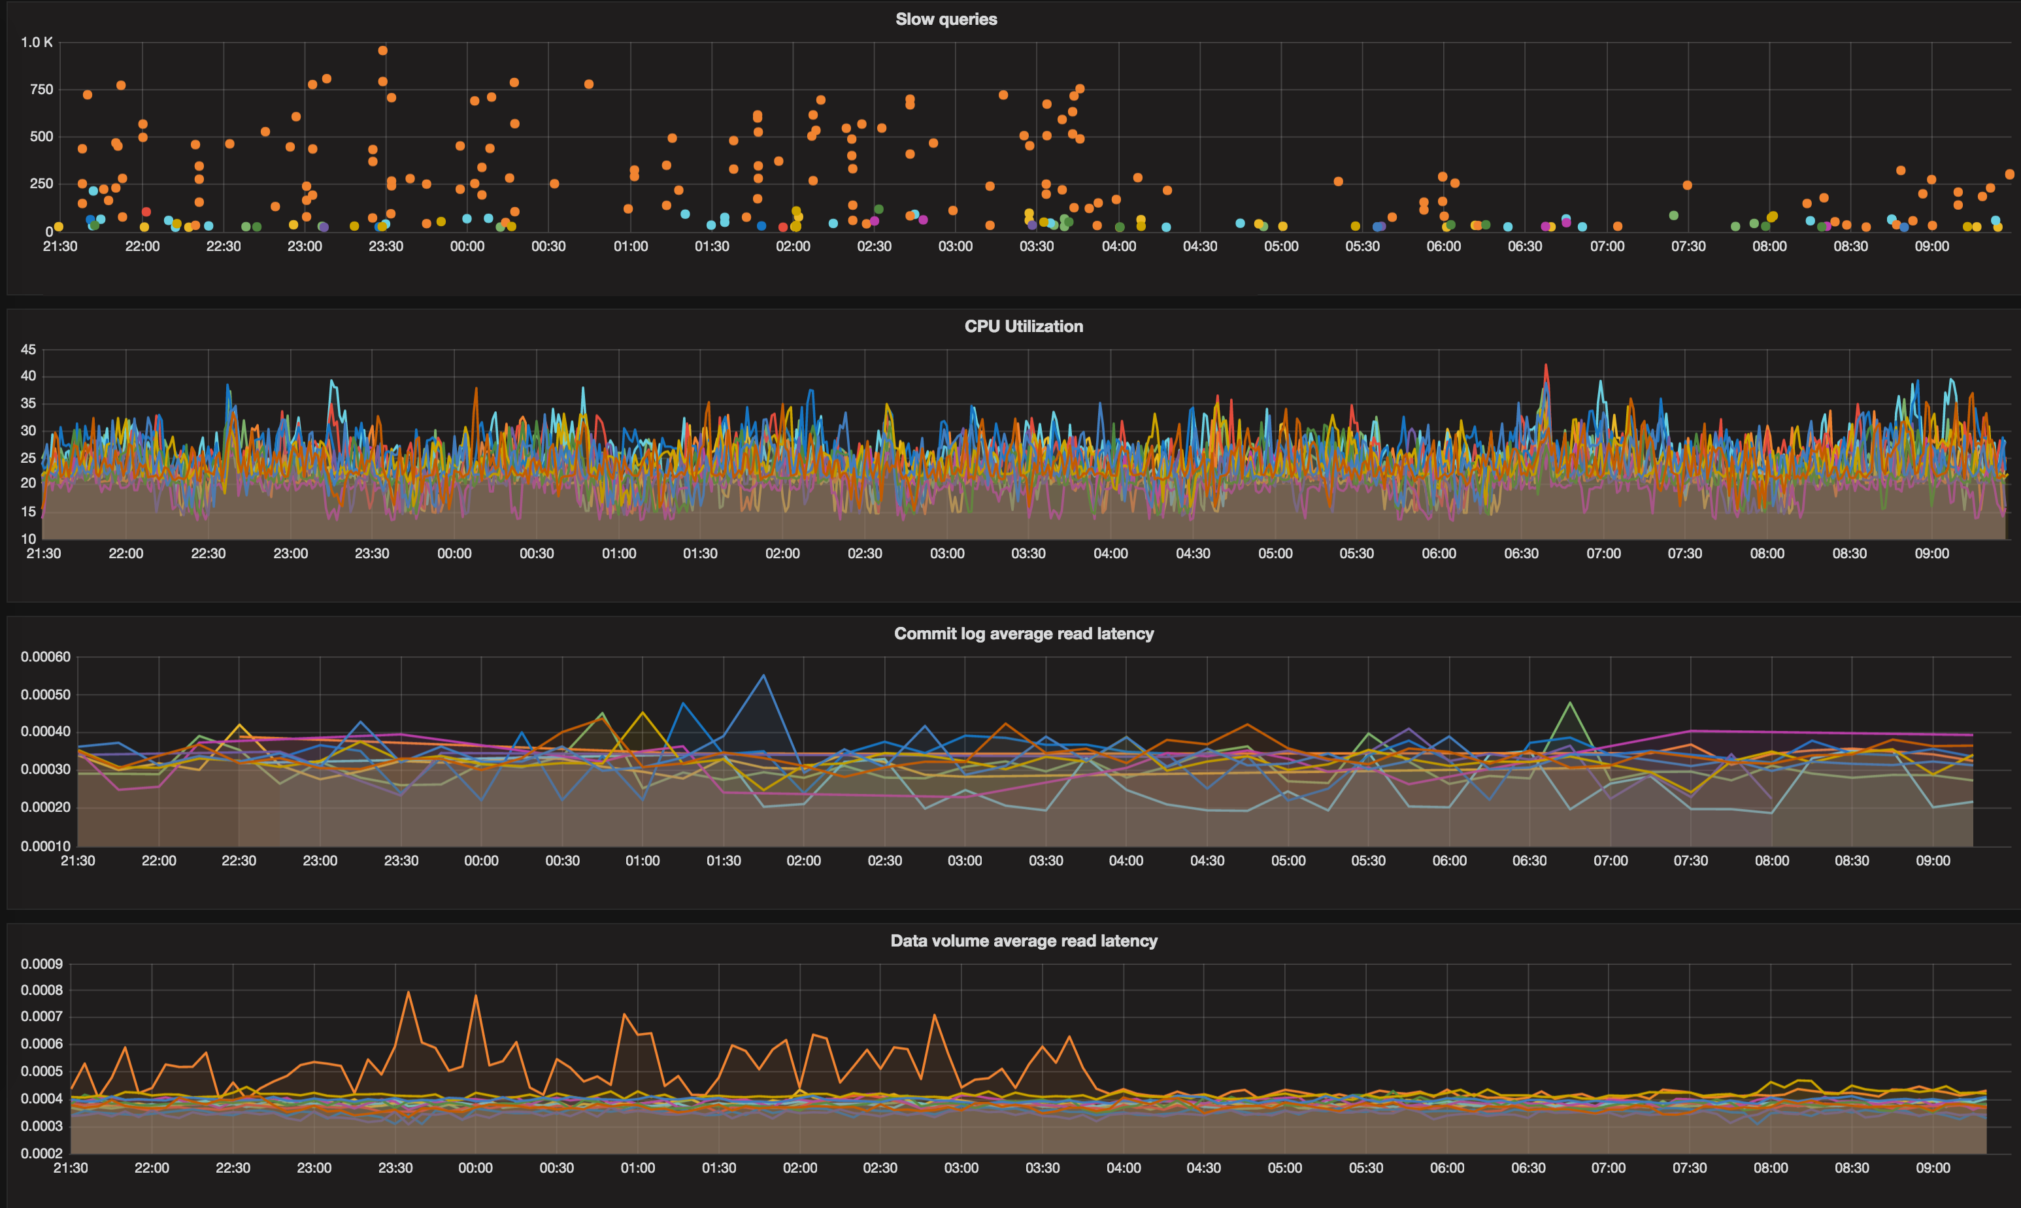
EBS volumes - problems
© DataStax, All Rights Reserved.

Slide 35
End result
Did we meet our goal?
Can we go any further?
© DataStax, All Rights Reserved.

Slide 36
Whats next?
Torture testing
Failure scenarios
Latency and delay inducers
Automate everything
© DataStax, All Rights Reserved.

Slide 37
Q&A

Slide 38
Thank you
Matija Gobec
matija@smartcat.io
@mad_max0204
smartcat-labs.github.io
smartcat.io

